Slide 1

Keep your
Data Science Efforts from Derailing
Sean Murphy - @sayhitosean
Marck Vaisman - @wahalulu
Data Community DC
@DataCommunityDC
Additional thanks to Harlan Harris - @HarlanH

Slide 2
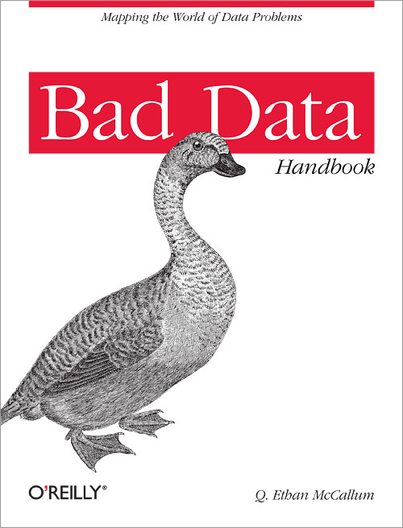

Background and Motivations
Writing the chapter for
The Bad Data Handbook
Starting Data Community DC,
Understanding our membership base
Lack of clarity in the field on
goals, skills, roles, career paths

Slide 3
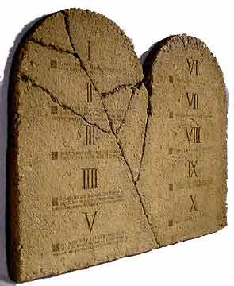
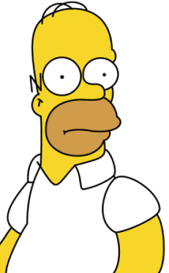
I) Know nothing about thy data
Know your data
Time spent up front is time well spent
Over 80% of time is spent cleaning data
Understand your data assets:
  How was it collected/generated?
  Where does it live?
  How is it formatted? Is formatting consistent?
  How is it stored?
  Are there missing values? If so, which ones, why?
  Where/how can you process it?
  Are there duplicated values, codes?

Slide 4

II) Thou shalt provide data scientists with one tool for all tasks
Provide and configure the right tools for the job
This is not a one-size-fits-all process
Production or R&D/ad-hoc?
Many tools, sources
  Databases (traditional, NoSQL)
  Legacy systems, Data Warehouses
  Flat files
  Analytics machine(s)
  Distributed/cloud computing (HDFS, S3)
  Open Source Software, libraries
Provide access and certain liberties (at least within R&D)
Consider security and privacy issues
Find a partner within your IT organization

Slide 5
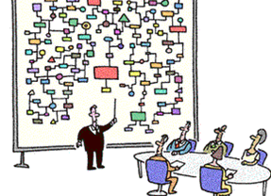
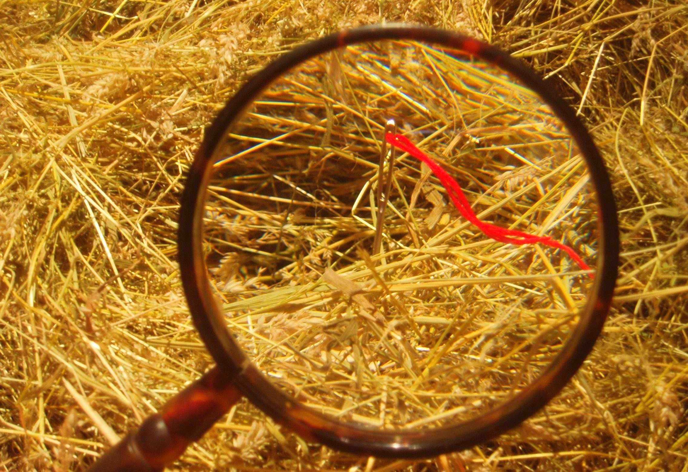
III) Thou shalt analyze for analysis’ sake only
Begin with the end in mind
Analysis for analysis’s sake is pointless
Lots of data or big data != Data Science or Value
Open ended exploration or solving specific problem
Focus on what is actionable
Avoid analysis paralysis
How prepared are you?
  You don’t even know where to begin:
  You have an idea of what you have, no previous analysis
  You know what you have, no previous analysis
  You know what you have, tried solving specific problems
Think broad: marketing, finance, operations, HR, product, etc.

Slide 6

IV) Thou shalt compartmentalize learnings
Share your learnings
Share
Break down silos
Doesn’t have to be complicated
Avoid duplicated efforts

Slide 7

V) Thou shalt expect omnipotence from data scientists
Get the right people for the job, and value their specific skills
Miscommunication leads to lost opportunities:
  excessive hype leads people to expect miracles, and miracle-workers
  a lack of awareness of the variety of data scientists leads organizations to wasted effort when trying to find talent
Notes:
We heard Daniel talk about interviewing data scientists, and about the unicorn. We had a discussion this morning about what that unicorn meant. I guess the best way to descri

Slide 8
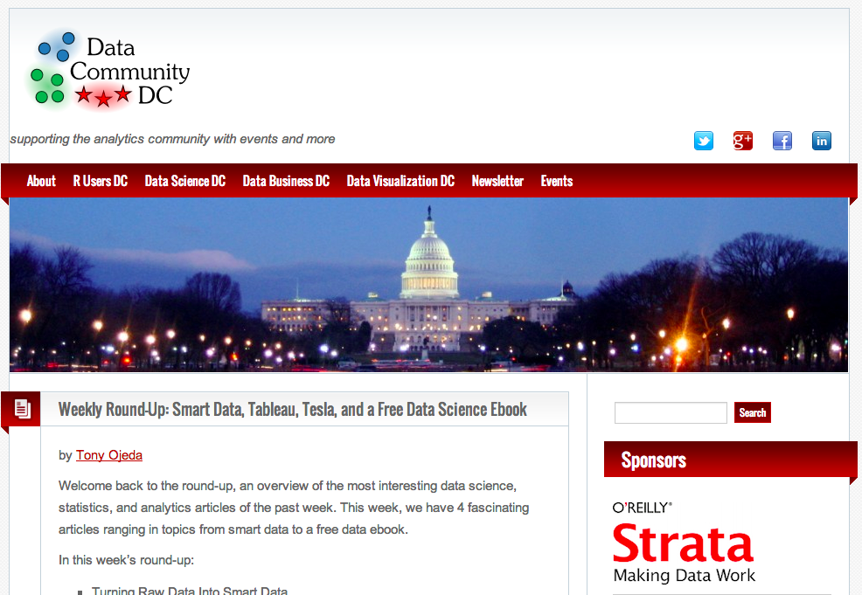
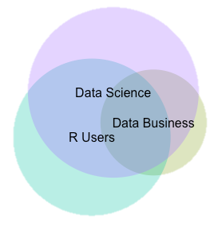
www.DataCommunityDC.org
Data Science DC (1808 members)
Data Business DC (369 members)
Data Visualization DC (329 members)
R Users DC
(1133 members)
Notes:
How can we, as a professional community, fix this problem? Perhaps by using the tools we know best -- data collection, data analysis, and data communication.
But not just any survey. We wanted to ask questions that would help us understand and define sub-groups -- not based on years of experience, or academic degrees, or titles -- but based instead on how data scientists think about themselves and their work. We didn’t ask about verticals, or pay scales, or org charts. We avoided tool and technique questions about database platforms or favorite statistical or machine learning techniques. Others have asked those questions, and the answers are interesting, but not relevant to our problem.

Slide 9
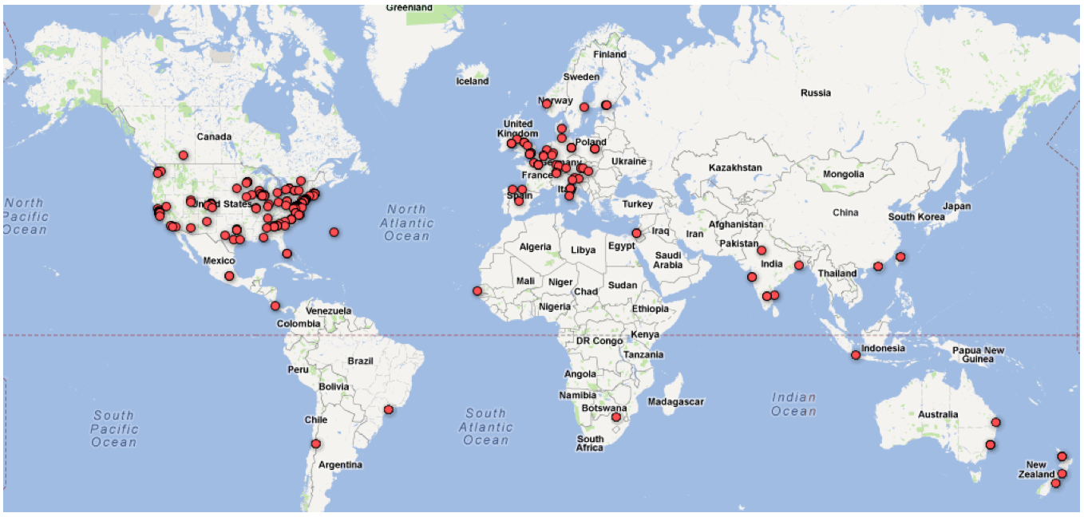
Greater than 250 completed surveys …

Slide 10
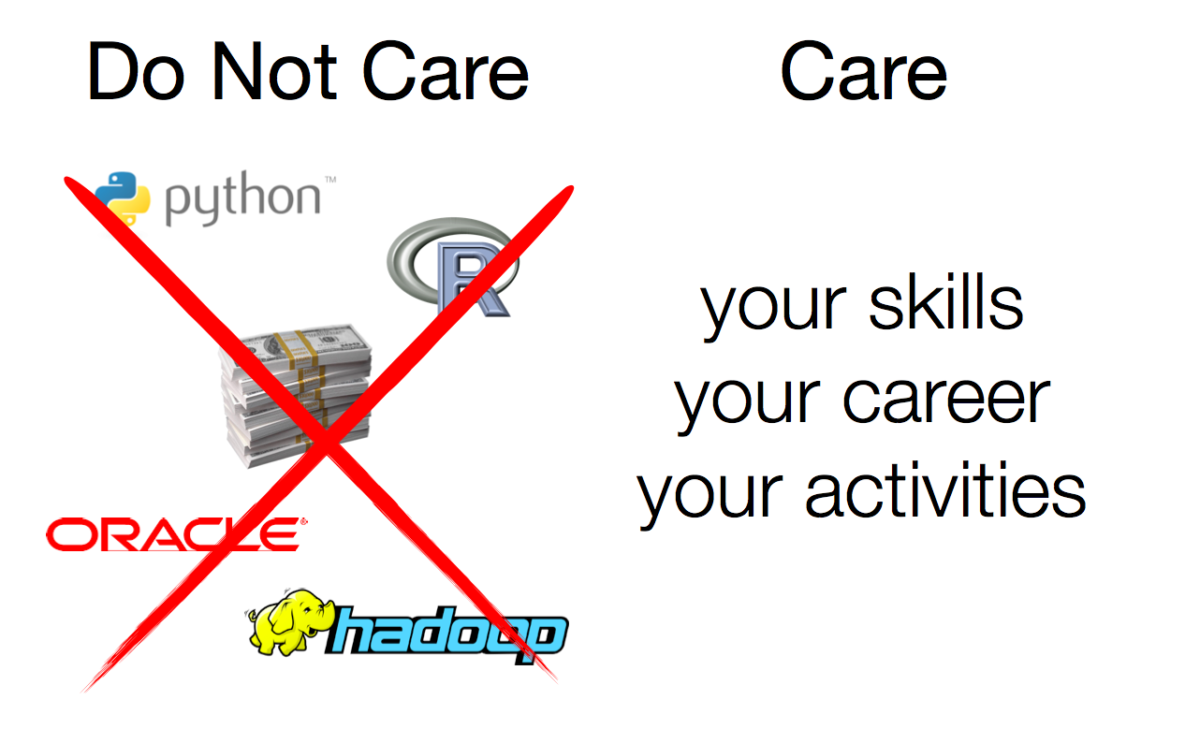

Slide 11
Skills
Self-Identification
Experiences
Education
Web Presence

Slide 12
On a scale of 1 to 10, how good are you at Math?

Slide 13
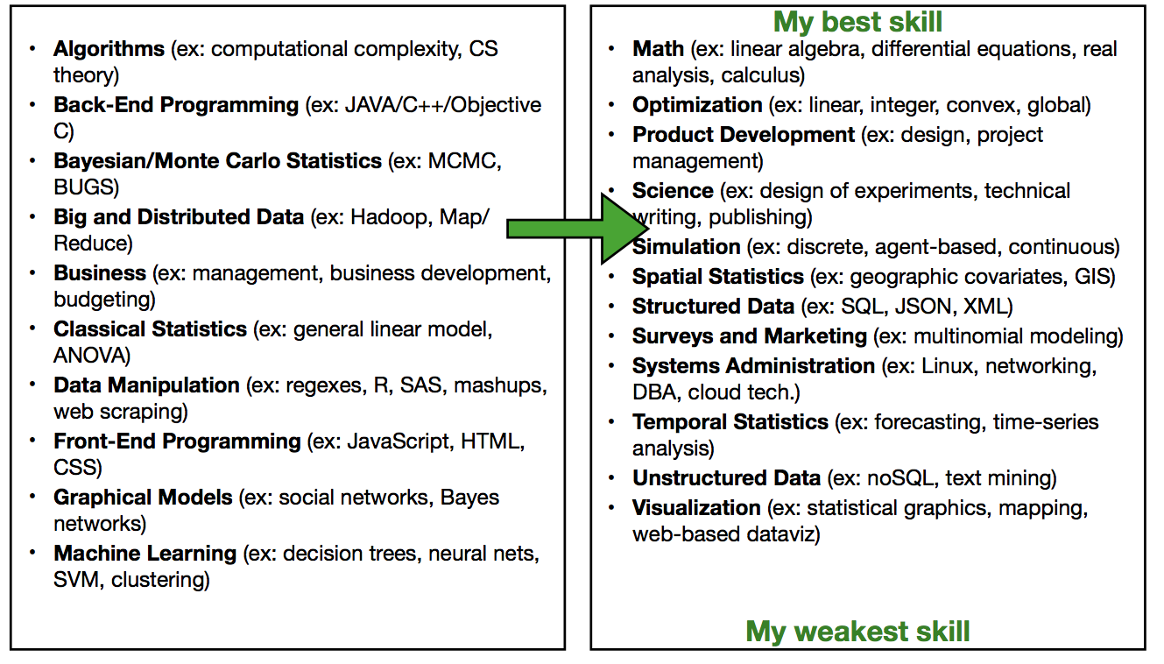
Self Ranked Skills

Slide 14
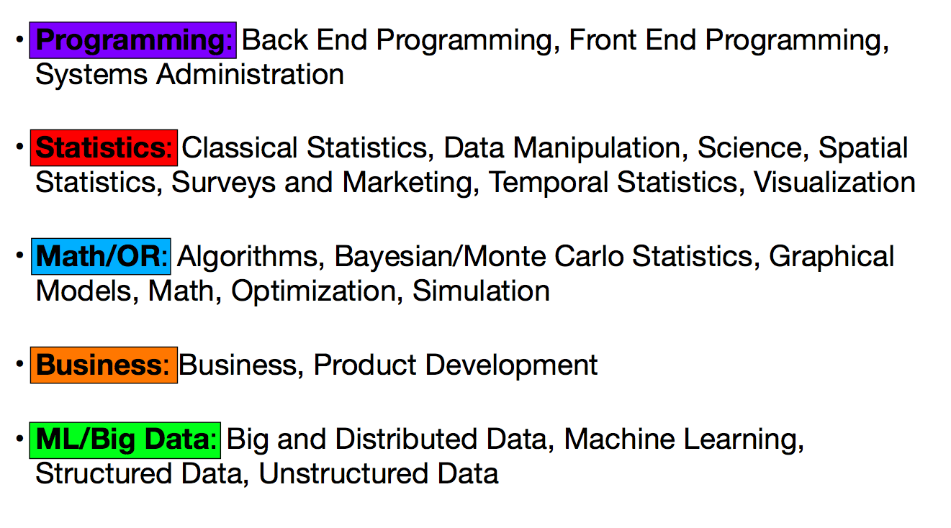
Self Ranked Skills

Slide 15
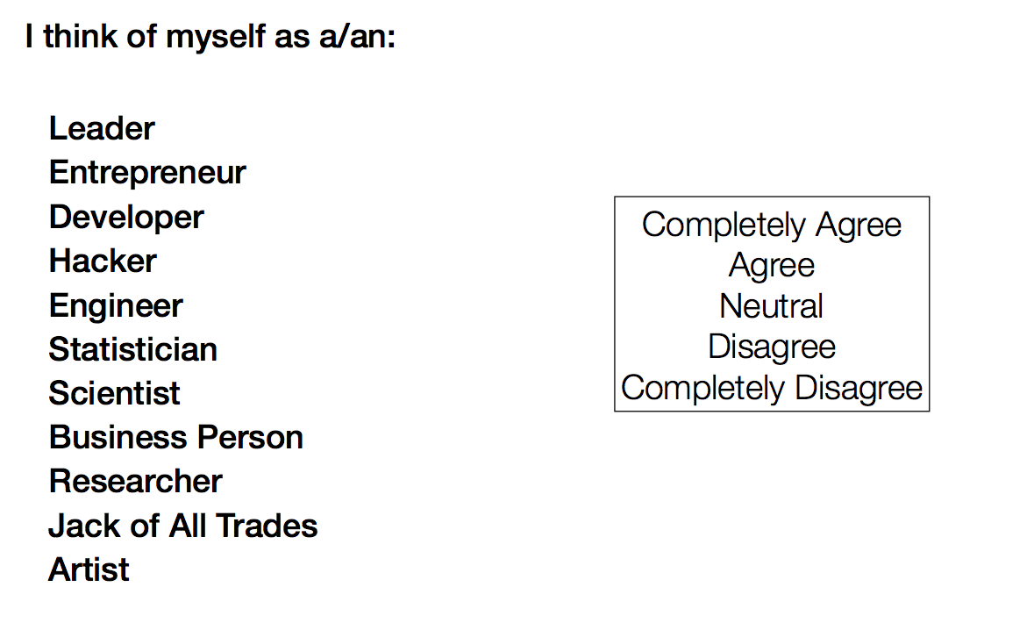
Self Identification

Slide 16
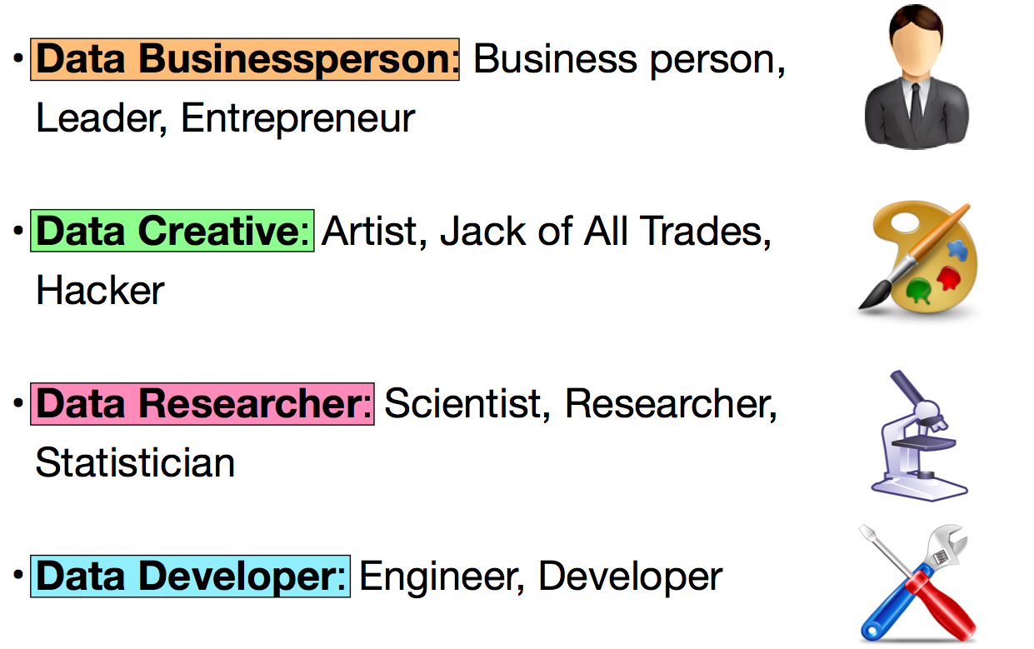
Self Identification

Slide 17
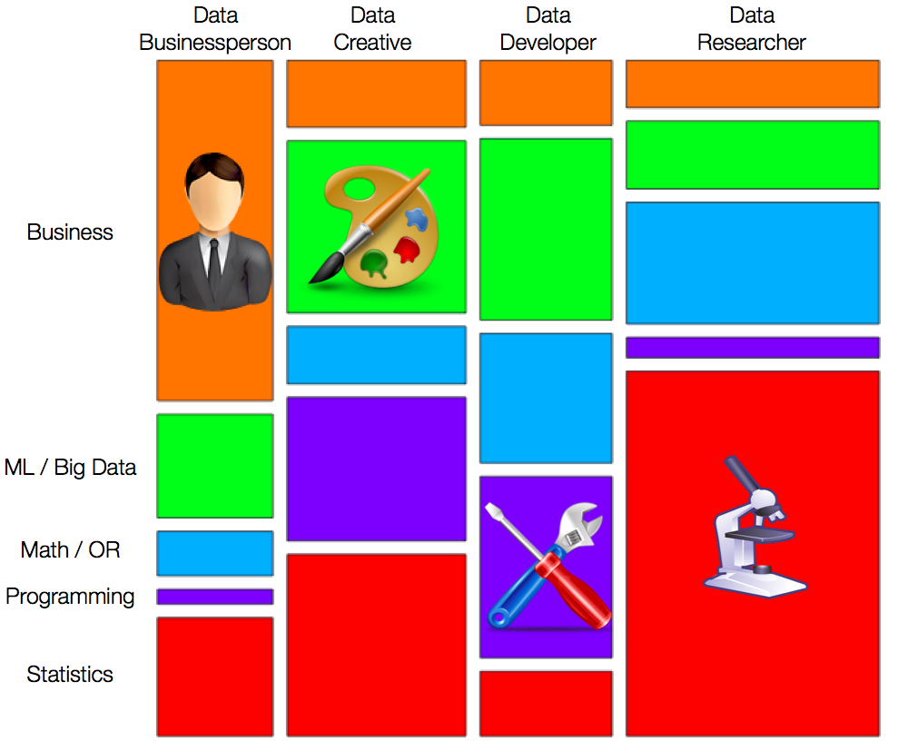

Slide 18

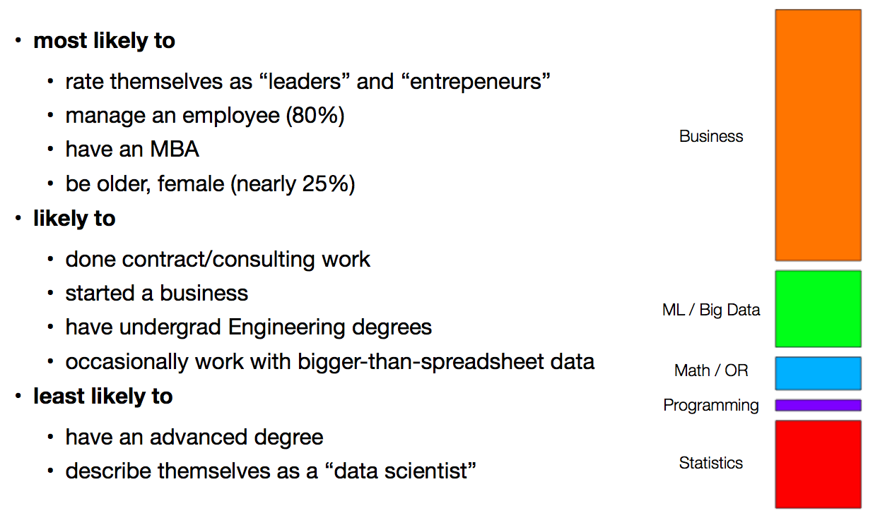
DataBusinessPerson

Slide 19

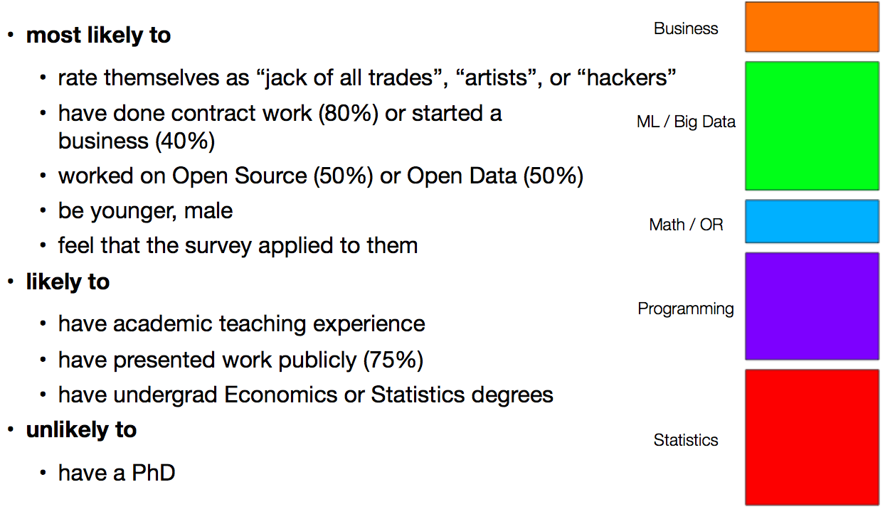
DataCreative

Slide 20

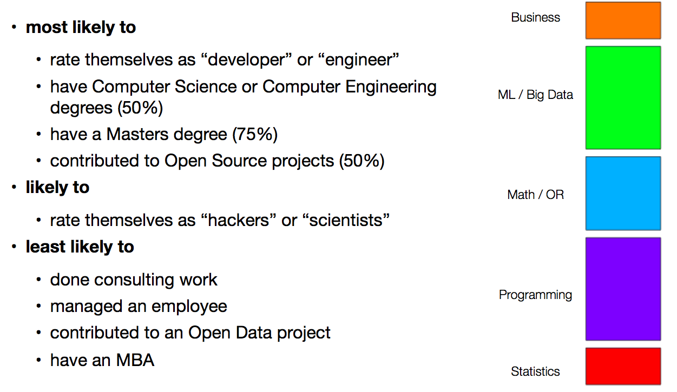
DataDeveloper

Slide 21

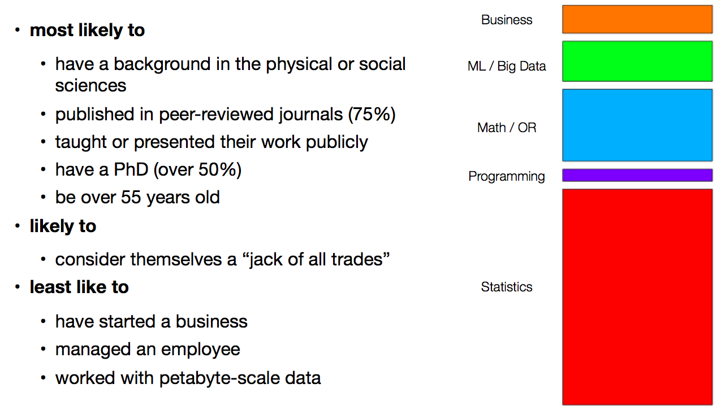
DataResearcher

Slide 22
Why bother?

Slide 23

Awareness

Slide 24
Common Language
DataResearcher
DataCreative
DataBusinessPerson
DataDeveloper

Slide 25
Efficiency
Do you write code that is deployed in operational systems?
Have you ever contributed to an open source project or open data initiative?
Why are frequentists wrong?
What does SWOT stand for?

Slide 26


survey.datacommunitydc.org
@wahalulu
marck@dataxtract.com
@SayHiToSean
SayHiToSean@gmail.com
Thank You!

